Slide 1
Neural Network
Monica Kadwe

Slide 2
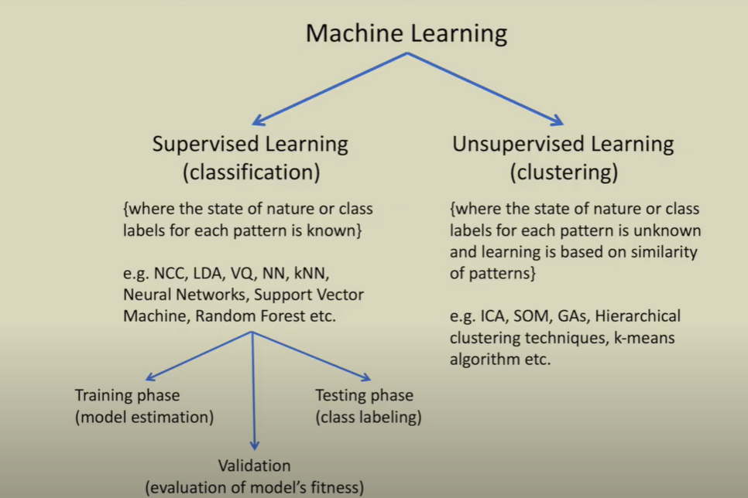

Slide 3
Classification & Clustering
Methods of pattern identification used in machine learning
Classification
Labelled data
Train data
Test new data
Regression
Clustering
Algorithm to identify patterns in the data
Makes data cluster
No expert information

Slide 4
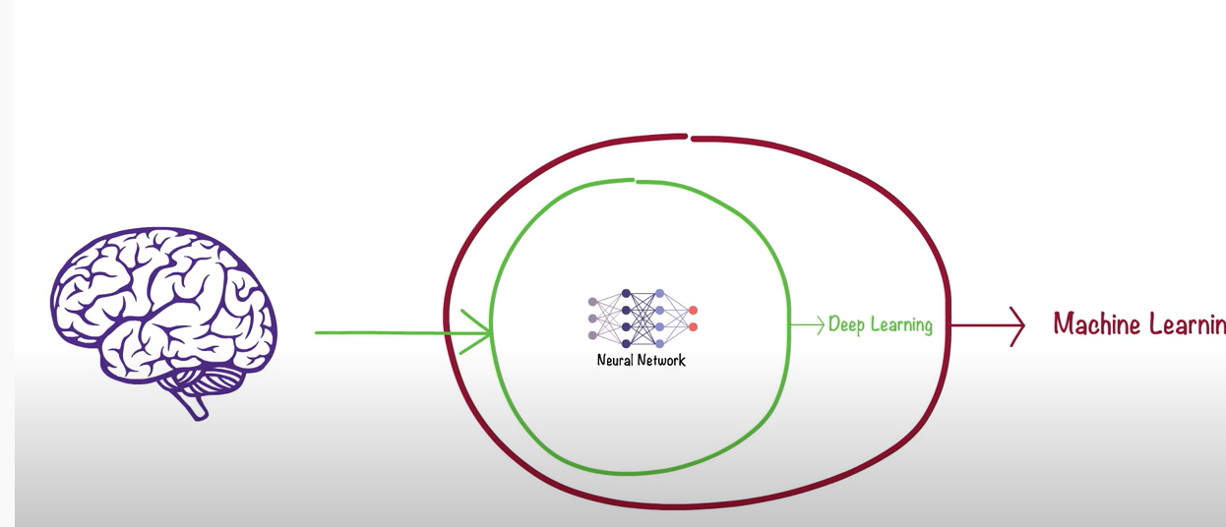
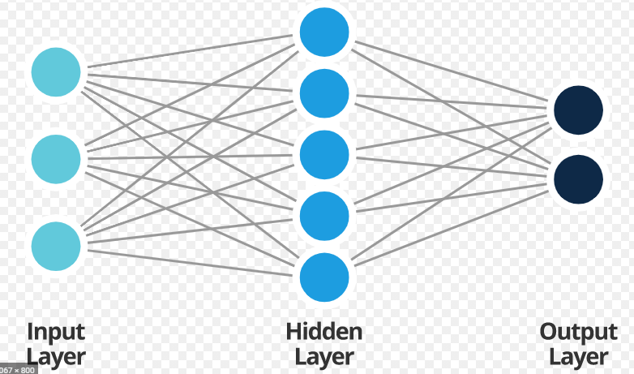
What is Neural Network?
Deep Learning
Inspired by human brain
Layers and perceptrons
Channels
Weight
Forward and Backward propagation
Take hours to months to train

Slide 5
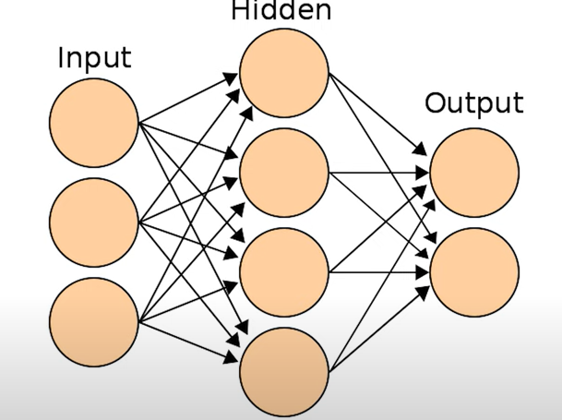
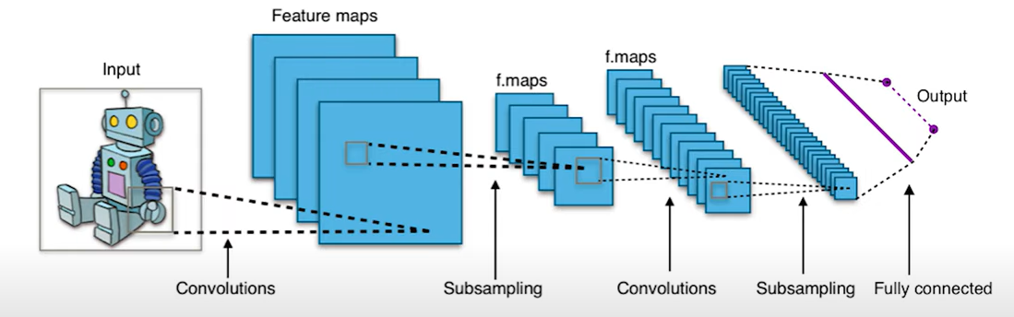
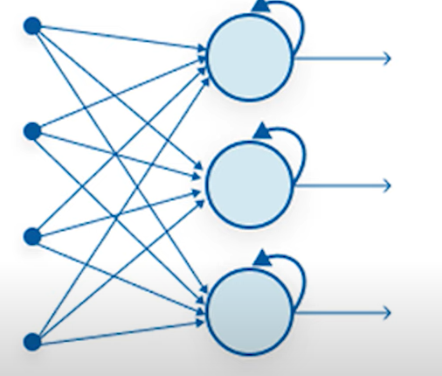
Types of Neural Network
Artificial Neural Network (ANN)
Convolutional Neural Network (CNN)
Recurrent Neural Network (RCN)

Slide 6
Application of Neural Network
Facial Recognition – age estimation
Forecasting
Music composition –
https://people.idsia.ch/~juergen/blues/IDSIA-07-02.pdf

Slide 7
Thank you

